Slide 1

Project 1 Part 2
Improving Web Content

Slide 2
Home Page
Header / same information as in the website
Picture & content on
Banner
2 Example of content you can choose 1 of them or design them all, then change it every new month
Example of Content
1
what we do
………...
The Mission
We are on a mission to empower underserved communities by providing technological resources to benefit people.
Programs Area
Gender
Education
Corporate
2
Program Name & details
Volunteer with us:
We strive to match your skills and interests with our organizational needs
what we have reached
Latest News
How can you help
Donate
Partner
volunteer
Partner logo
Footer / same information as in the website
Subscribe

Slide 3
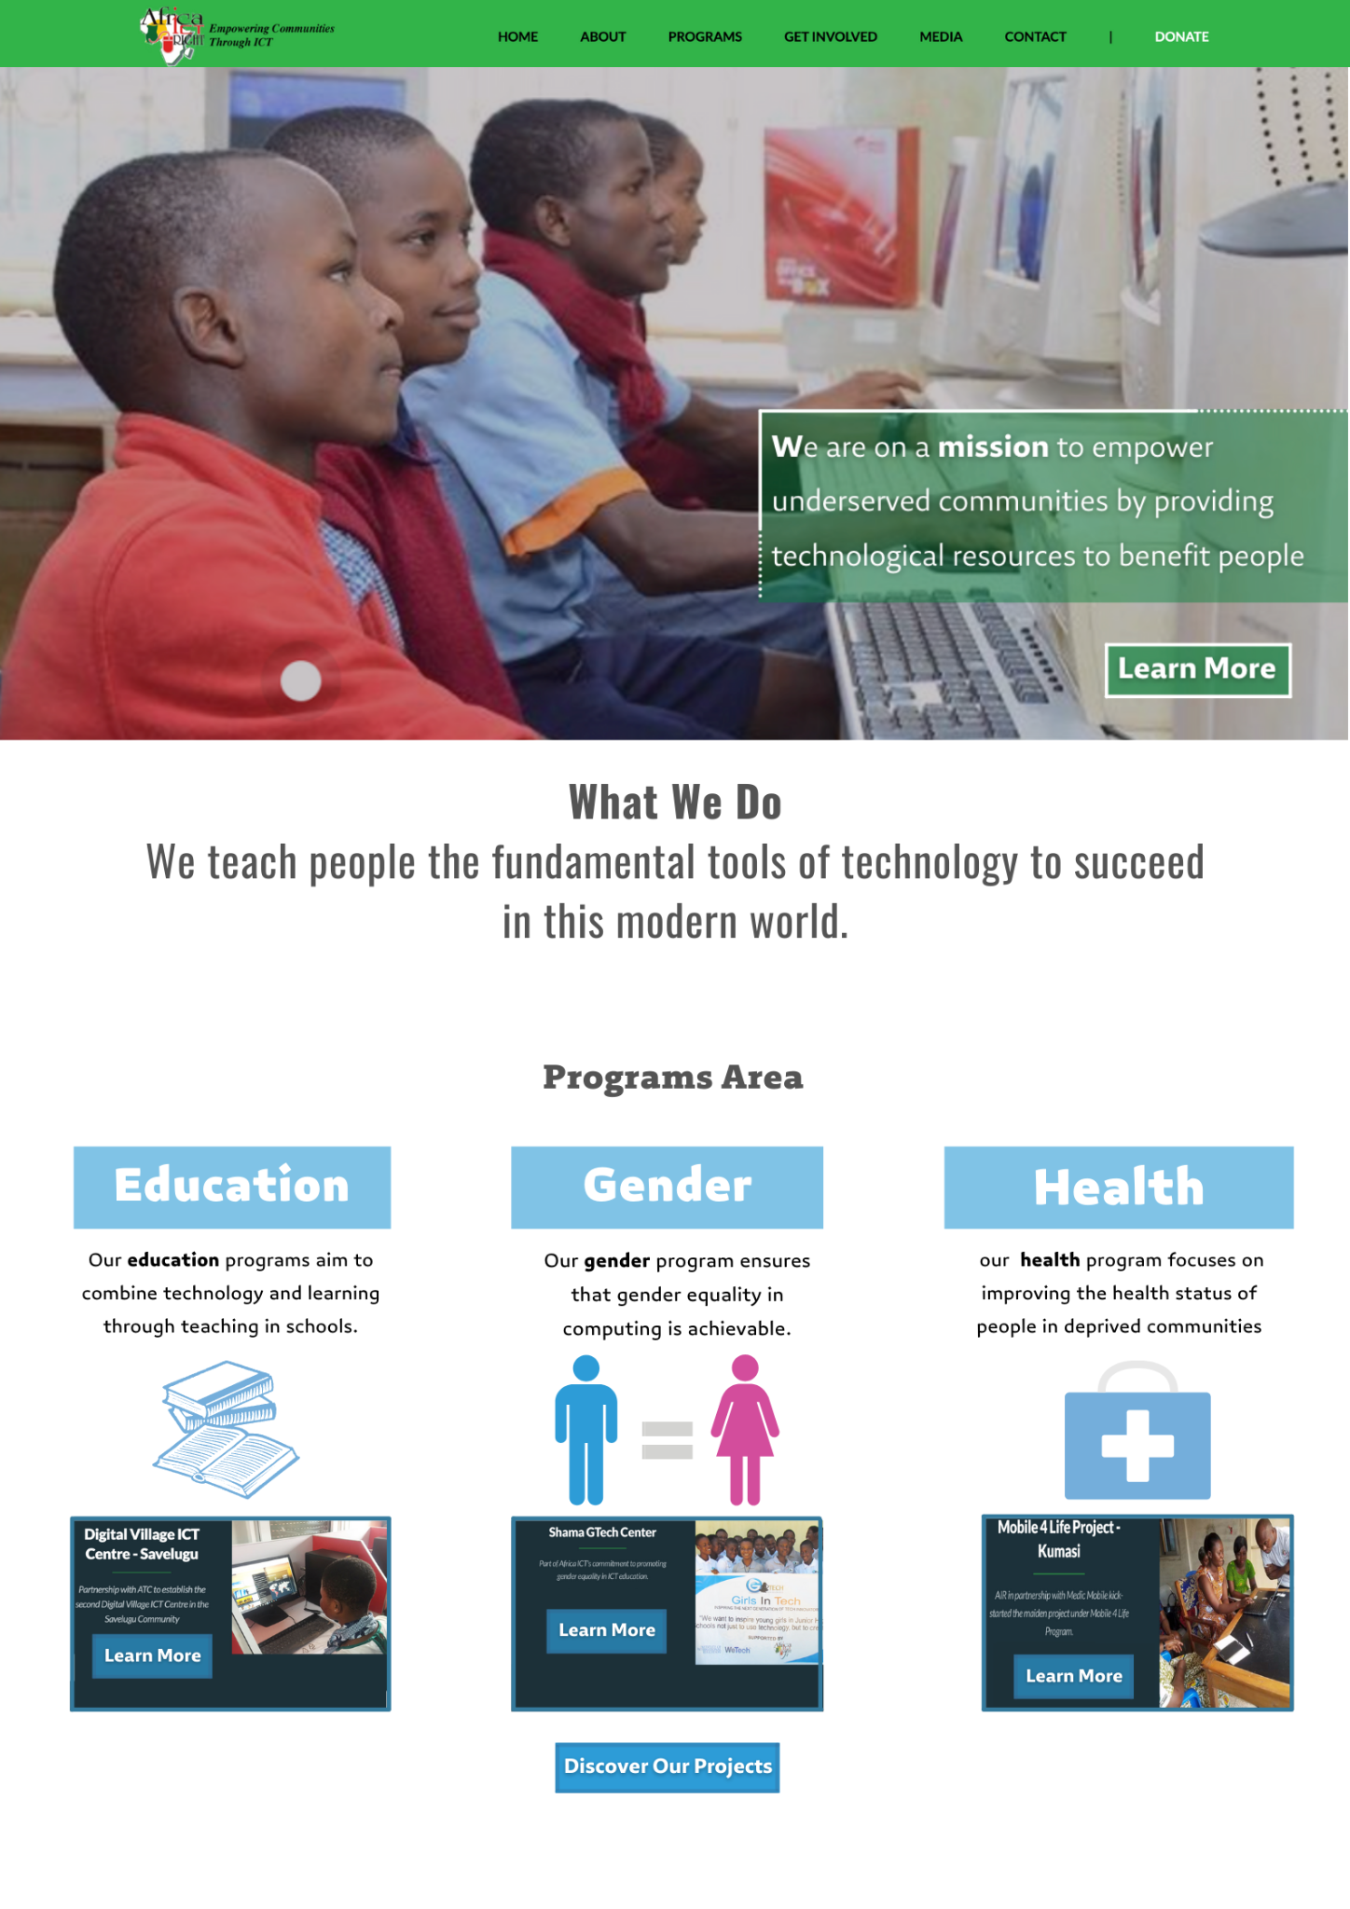
Home Page / Part 1
Example 1
The difference between these 2 examples is in the banner (picture & content)
When you click “ Learn More” it will take you to the about page
The Mission
We are on a mission to empower underserved communities by providing technological resources to benefit people.

Slide 4
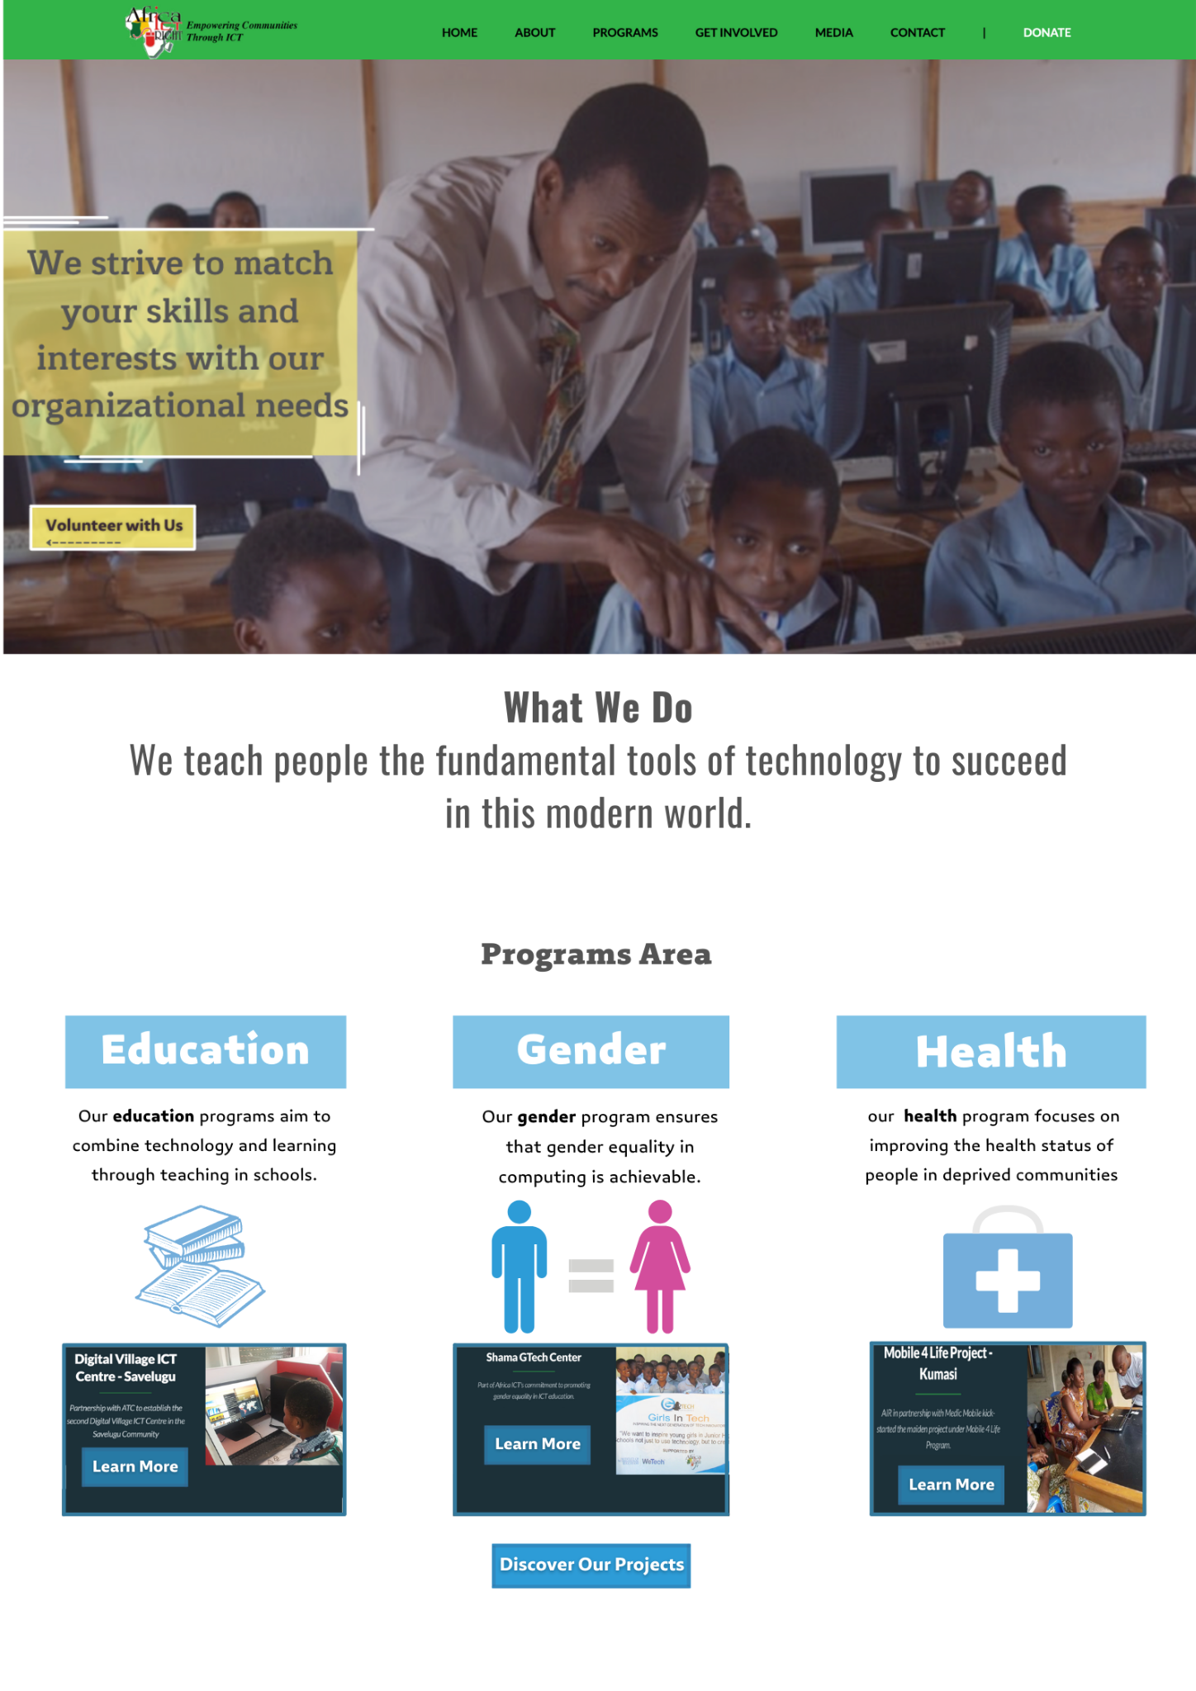
Home Page / Part 1
Example 2
The difference between these 2 examples is in the banner (picture & content)
when you click “ Volunteer with us” it will take you to the volunteer page
Volunteer with us:
We strive to match your skills and interests with our organizational needs

Slide 5
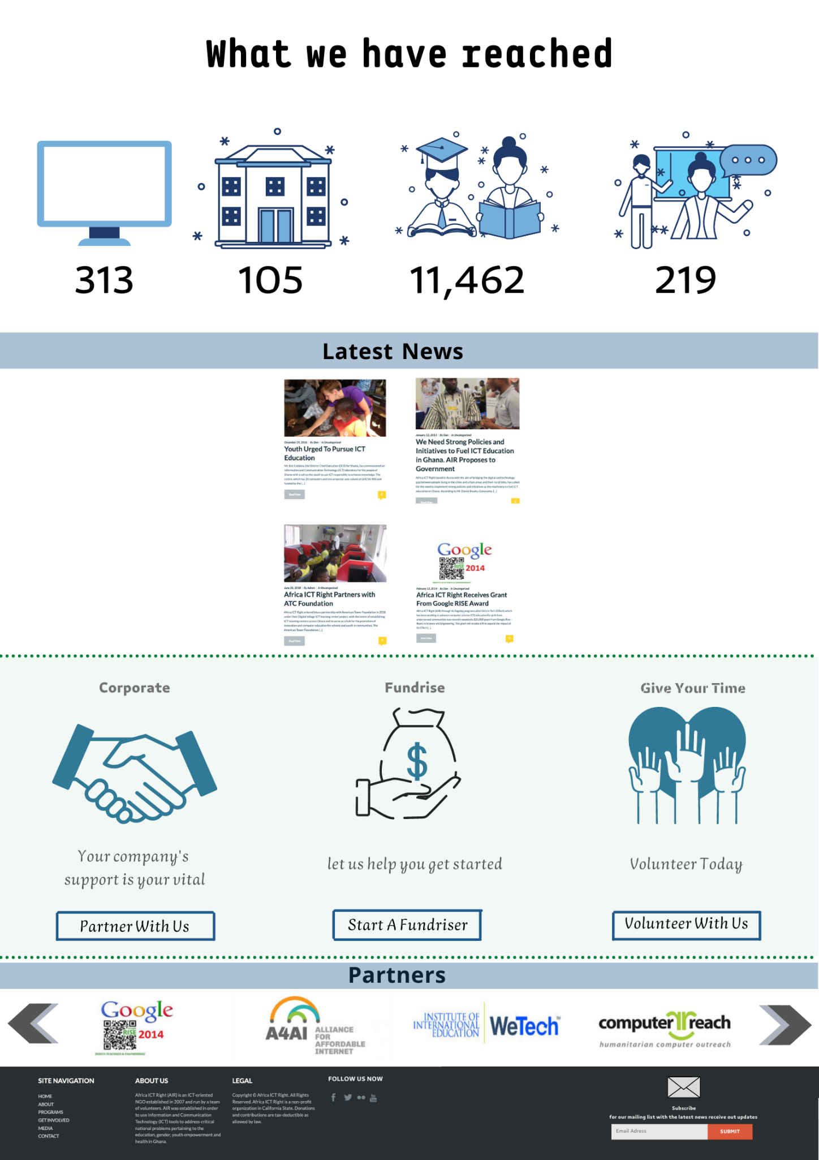
Home Page / Part 2

Slide 6
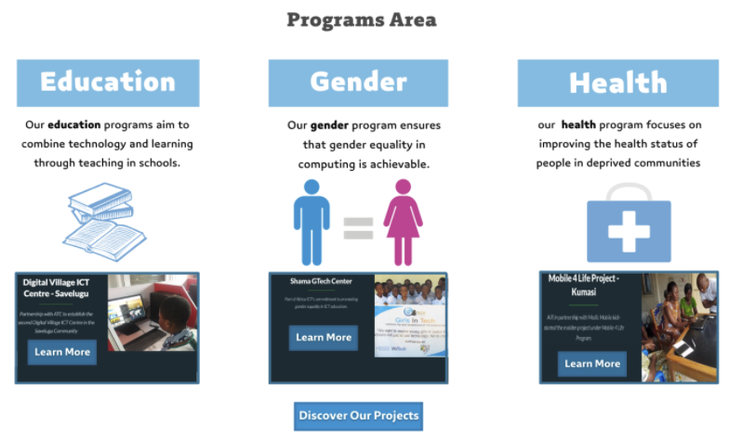
Home Page / Middle
Re-editing the description

Slide 7
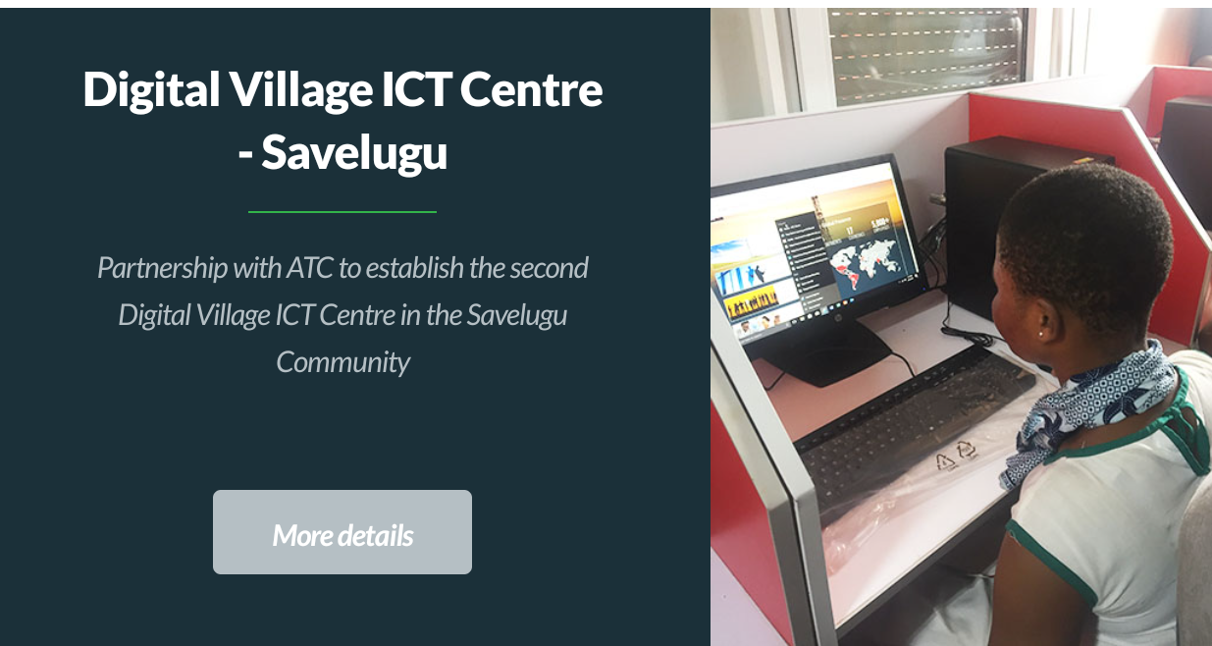
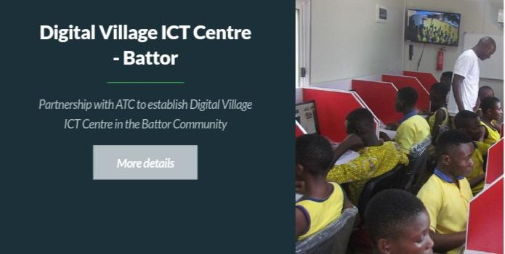
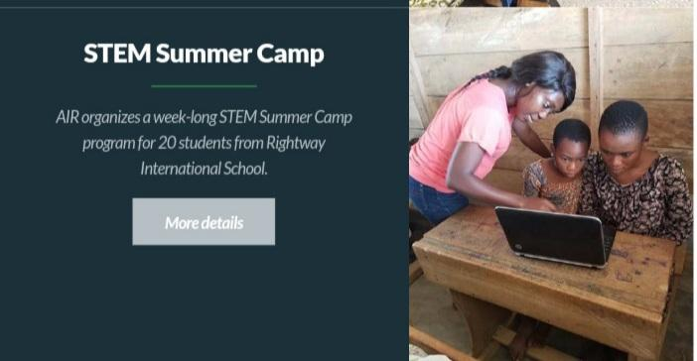
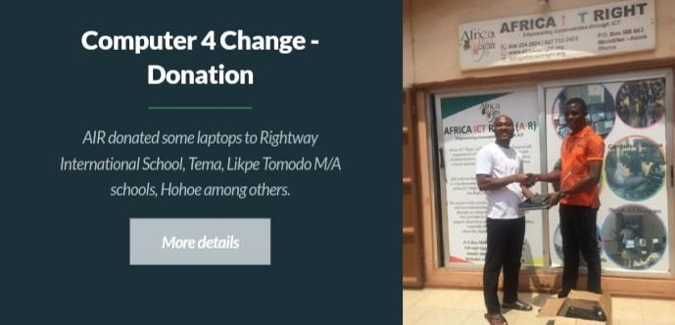
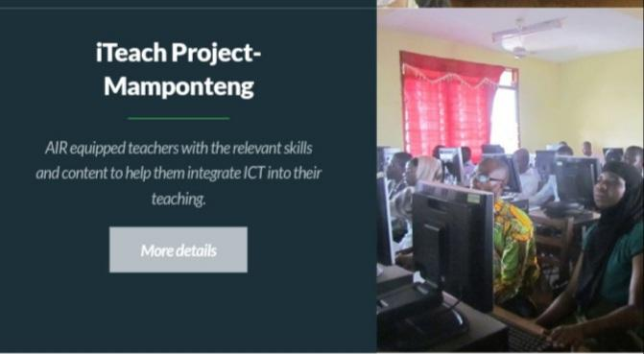
Home Page / Middle / Education
Education
The (discover our projects) tab will take us to the page that includes all the projects, but they will be organized based on the areas.

Slide 8
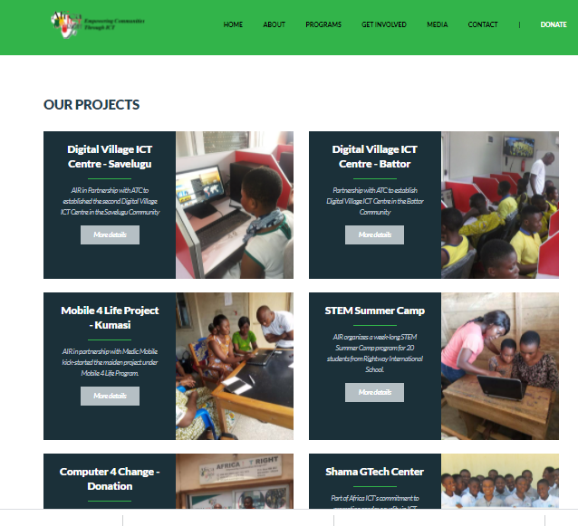

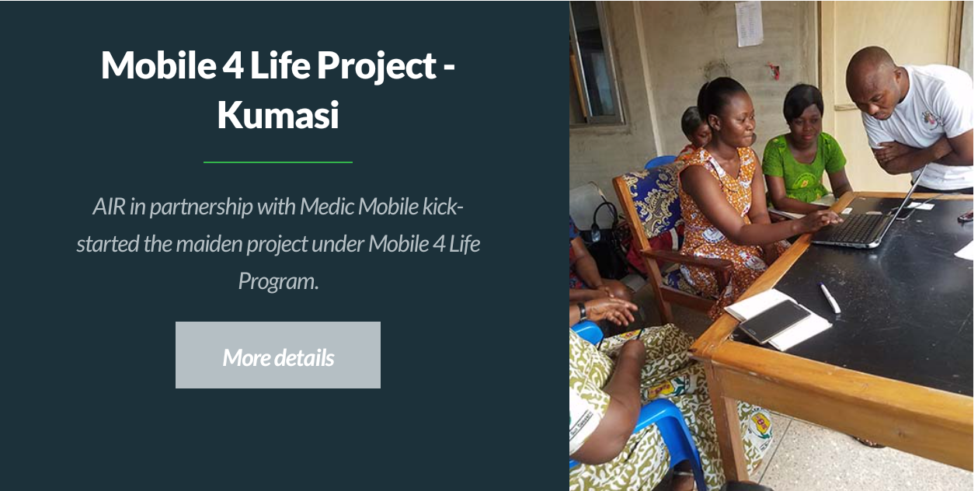
Home Page / Middle
Gender
This organizing of the project page will be better than the old page.
Health

Slide 9
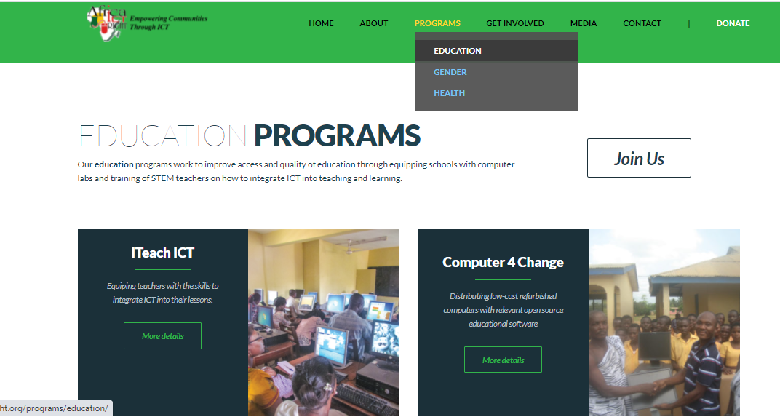
Home Page / Middle
Like this one, it is still the same
The program areas in the header will be the same . And each area has the projects specifically with all the description of each one of them.

Slide 10
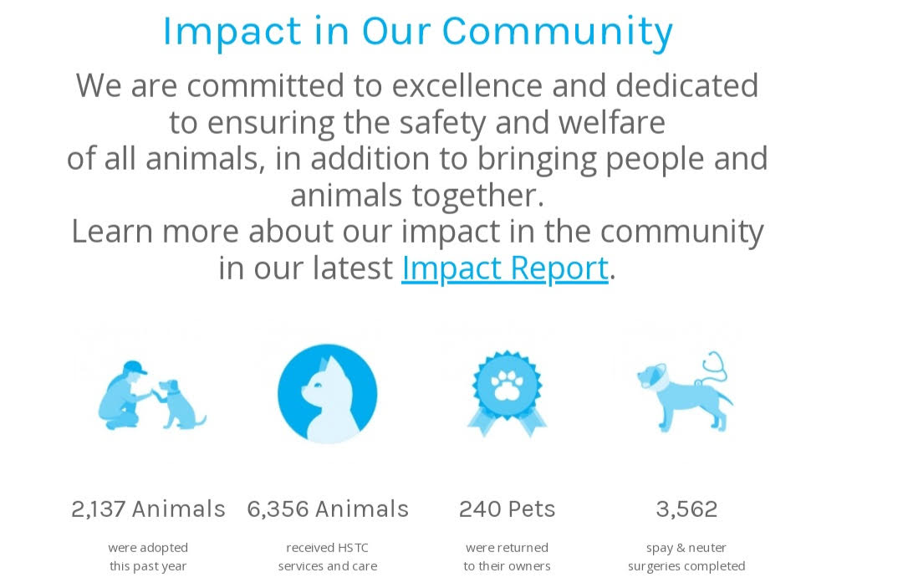
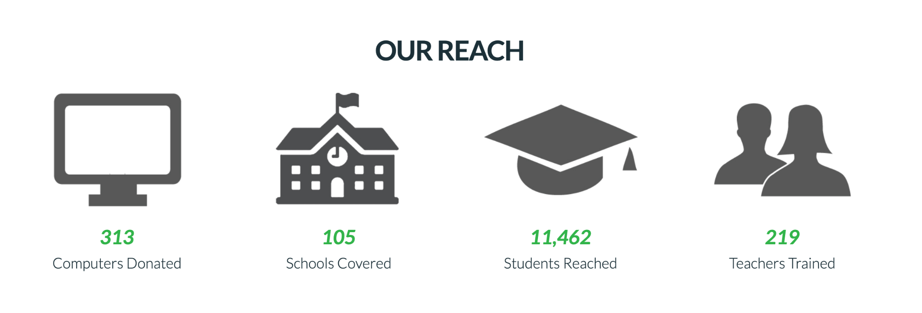
Home Page / Middle
Change The Subject & Add Colors & Active Numbers
change the subject to
(( So far we have reached )).
add more colors for the content and the icons to make them more active.
Use live numbers when we open the website as an example:
https://www.rti.org/
Example
Current

Slide 11
Home Page / Middle
Editing The Sentence:
NEWSLETTER SIGN-UP
Get the latest news about Africa ICT and IT Development in Ghana, right in your inbox!
Subscribe Now
Get In Touch
Stay informed to receive our up-to-date news of Africa ICT by signing up to the newsletter.

Slide 12
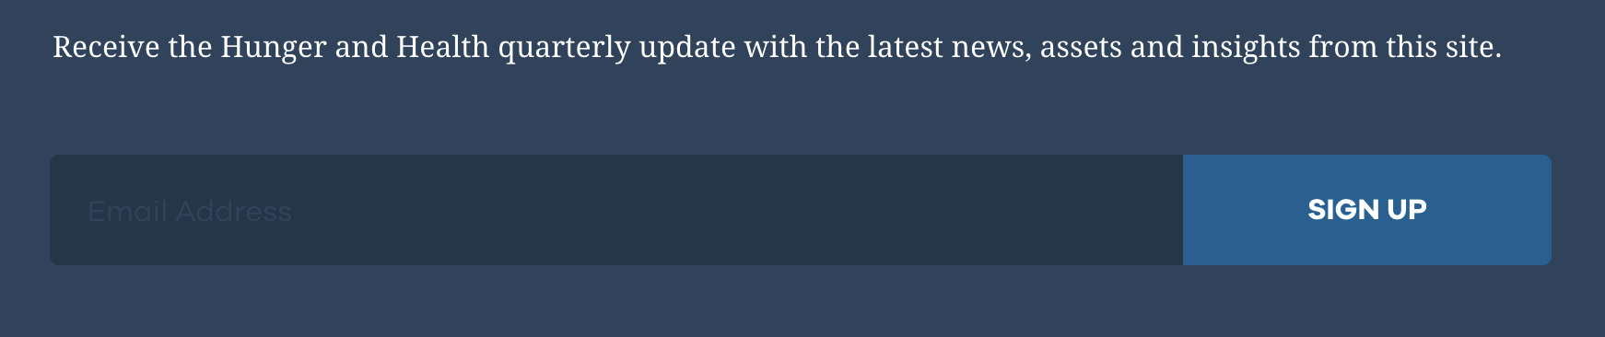

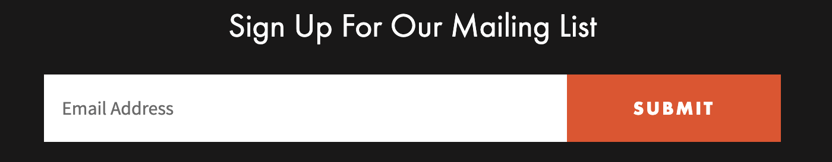
Home Page / Middle
Edit To Our Mailing Newsletter Content:
Subscribe For Our Mailing List with the latest newsreceive out updates , assets and insights from this site

Slide 13


Home Page / Middle
Change Subject & Allow Partner To Move:
Change the subject for the partner from the home page to
(( PARTNER )) as it show in partner page
make the partner in one line and move them by clicking in the left or right, as it can be seen in the link:
https://ertiqa.org/

Slide 14

Home Page / Footer
Add Encourage Words For Users:
-It would be more encouraging to write
(( Follow us now ))
-add colors for the icons
-add Linkedin account on the website
Follow us now
FIND US ELSEWHERE

Slide 15
General Content Comments

Slide 16
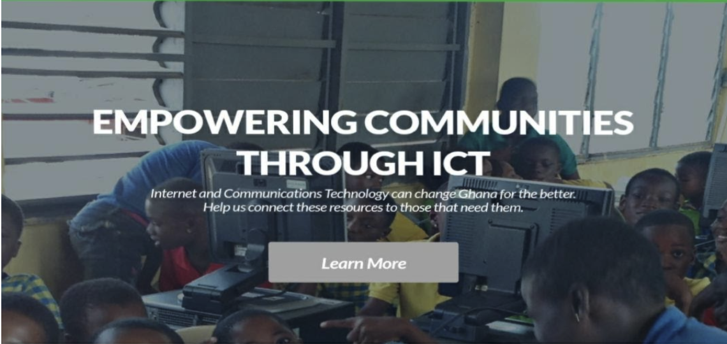
Home Page / Header
Editing The Statement:
Our aim is strengthening societies potentials with the power of ICT.
Internet and Communication Technologies will enhance the life of Ghana’s people
Be the one who support us in our journey.

Slide 17
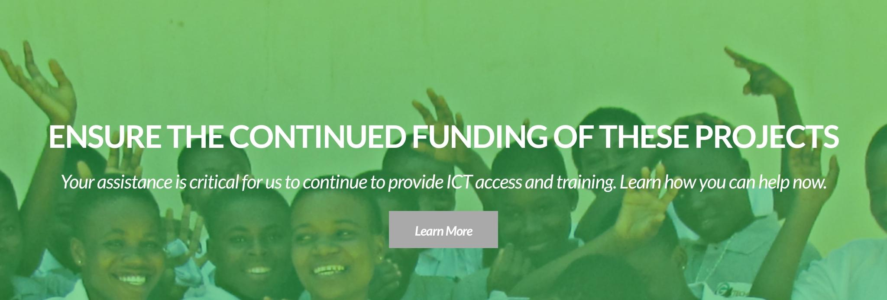
Home Page / Header
Editing The Sentence:
We believe in the importance of your role to fund our projects.
Click learn more to transform lives.

Slide 18
Home page/Header
Home Page / Header
Re-edit to (What We Do) Section:
( What we do ) section can be reduced in this page, then ( learn more.. ) tab can show the detailed information.
AIR was established in order to use Information and Communication Technology (ICT) tools to address critical national problems pertaining to the education, gender, youth empowerment and health in Ghana.
AIR believes the modern world is in the midst of a profound transformation in which personal computers, mobile phones and Internet technologies play critical role but there is great inequality in the distribution of these tools, which is detrimental not only to underserved communities, but also to our society

Slide 19
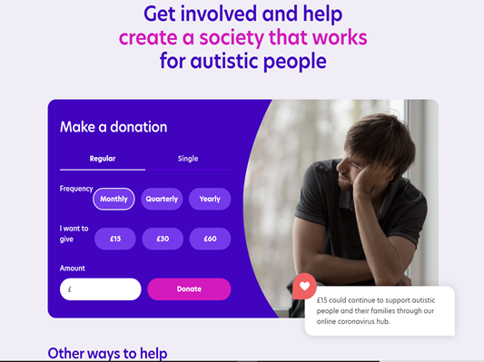
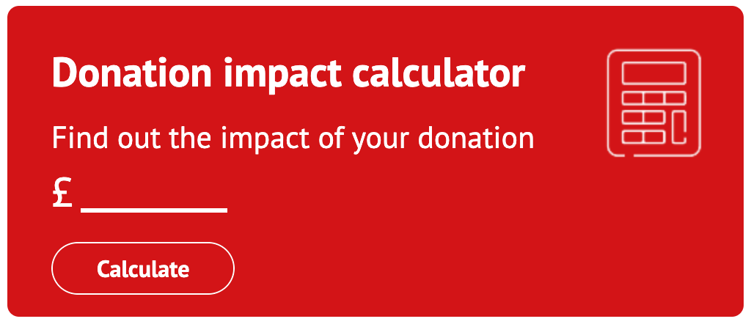
Home Page / Middle
Home page/Middle
Donation At the Home Page:
Option to donate should be placed on the home page and prominently so that it becomes easier for the user to donate faster.
The content must be:
1- Get involved and help
create a society that works
in connecting technologies for people.
or
2- Donation impact calculator
Find out the impact of your donation
$................

Slide 20
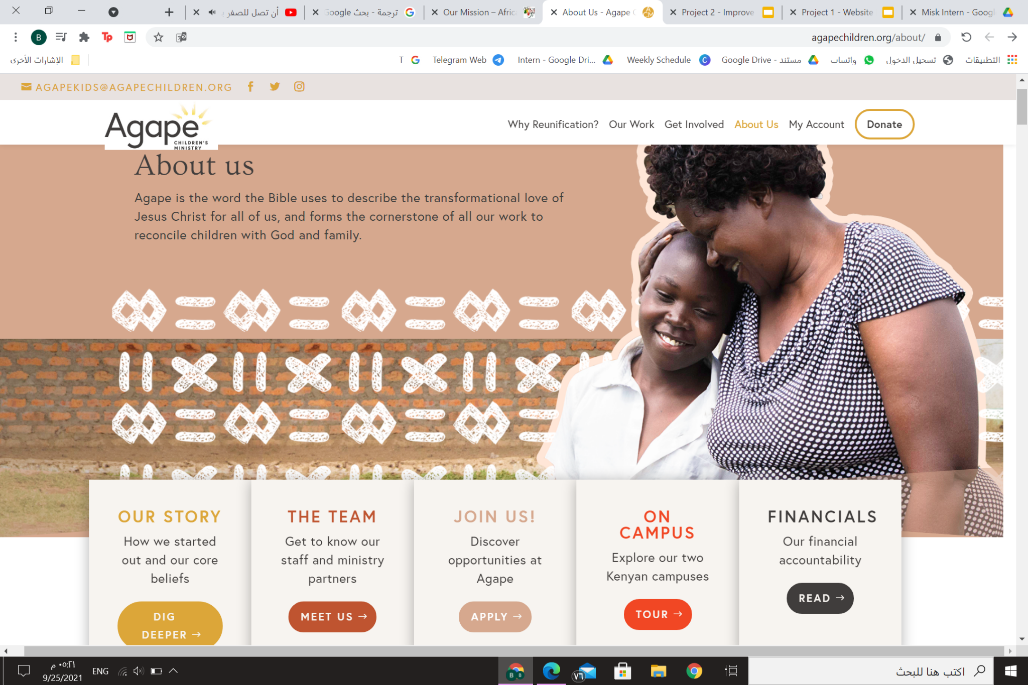
About/Header
Home Page / Header
Re-arrange The Page As:
- Put a picture + add introduction
-Add boxes to connect the user to
( Our Vision - Our Team - our story)

Slide 21
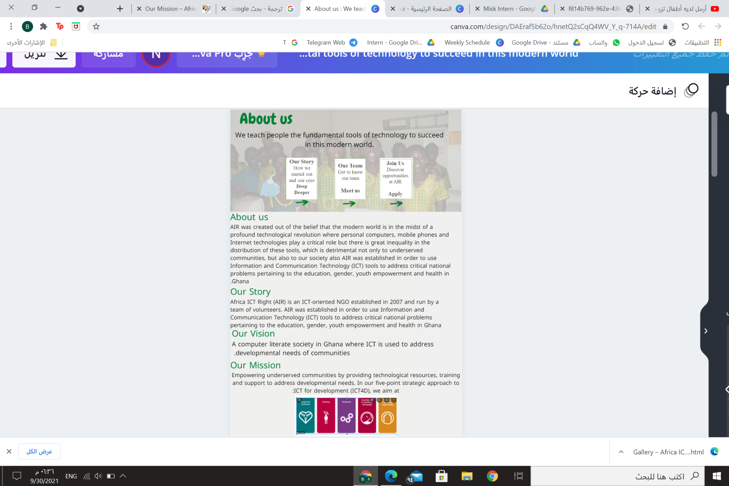
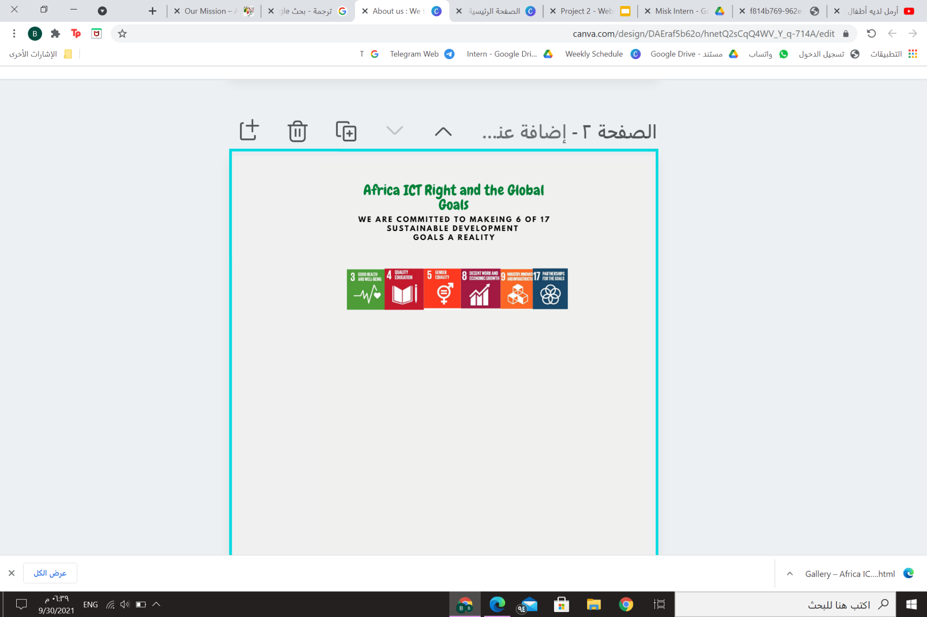
About/Header
About / Content

Slide 22
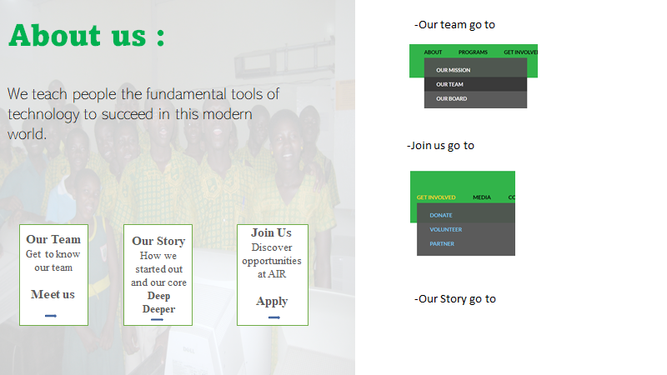
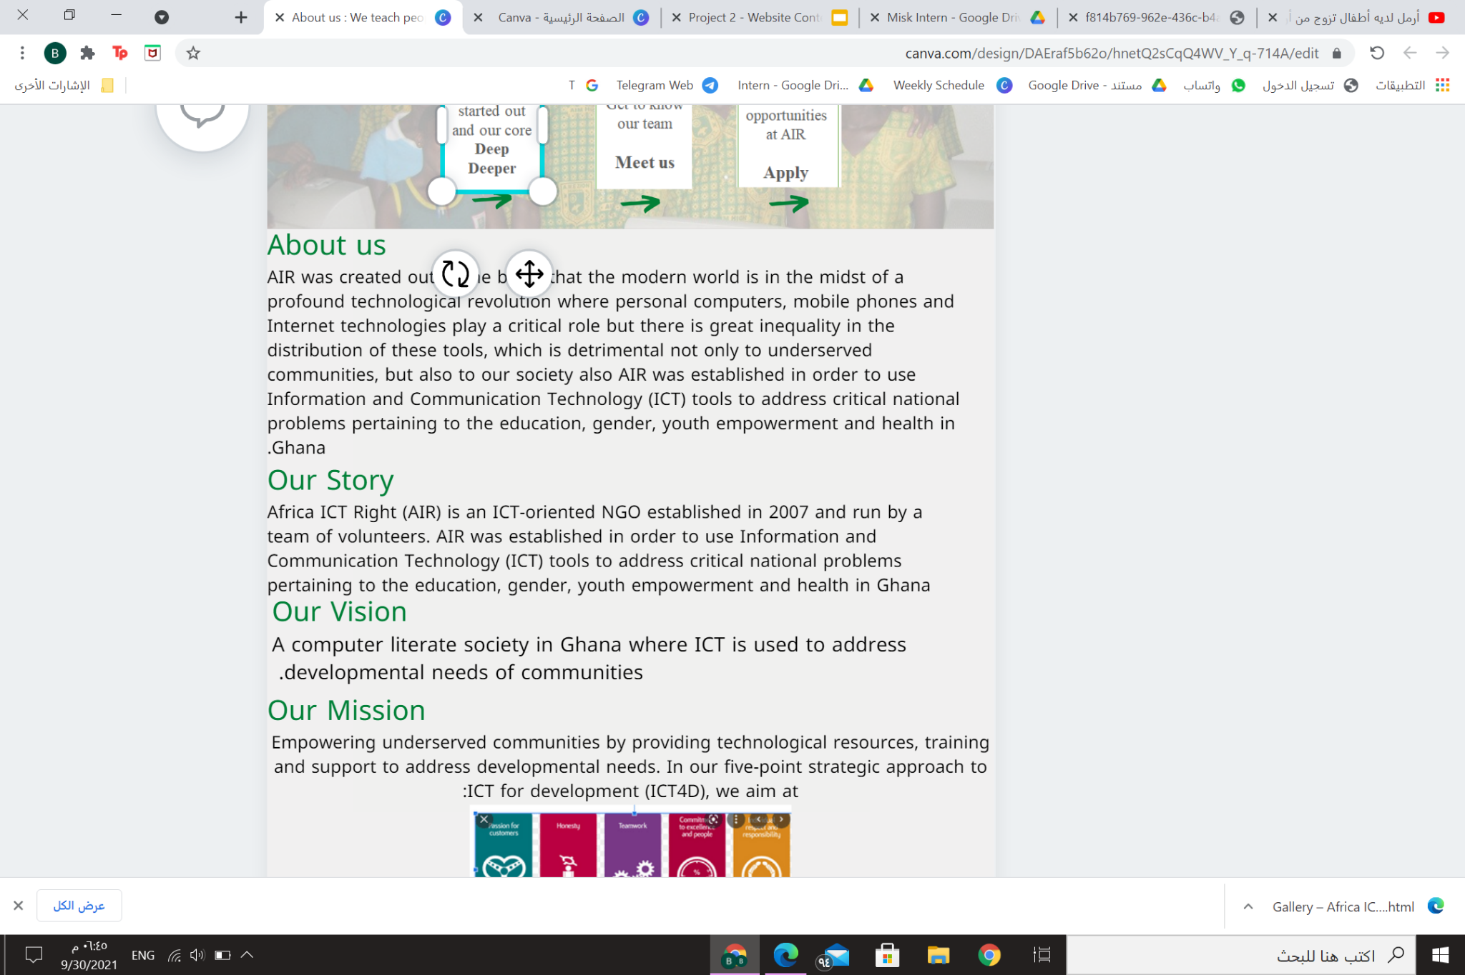

Slide 23
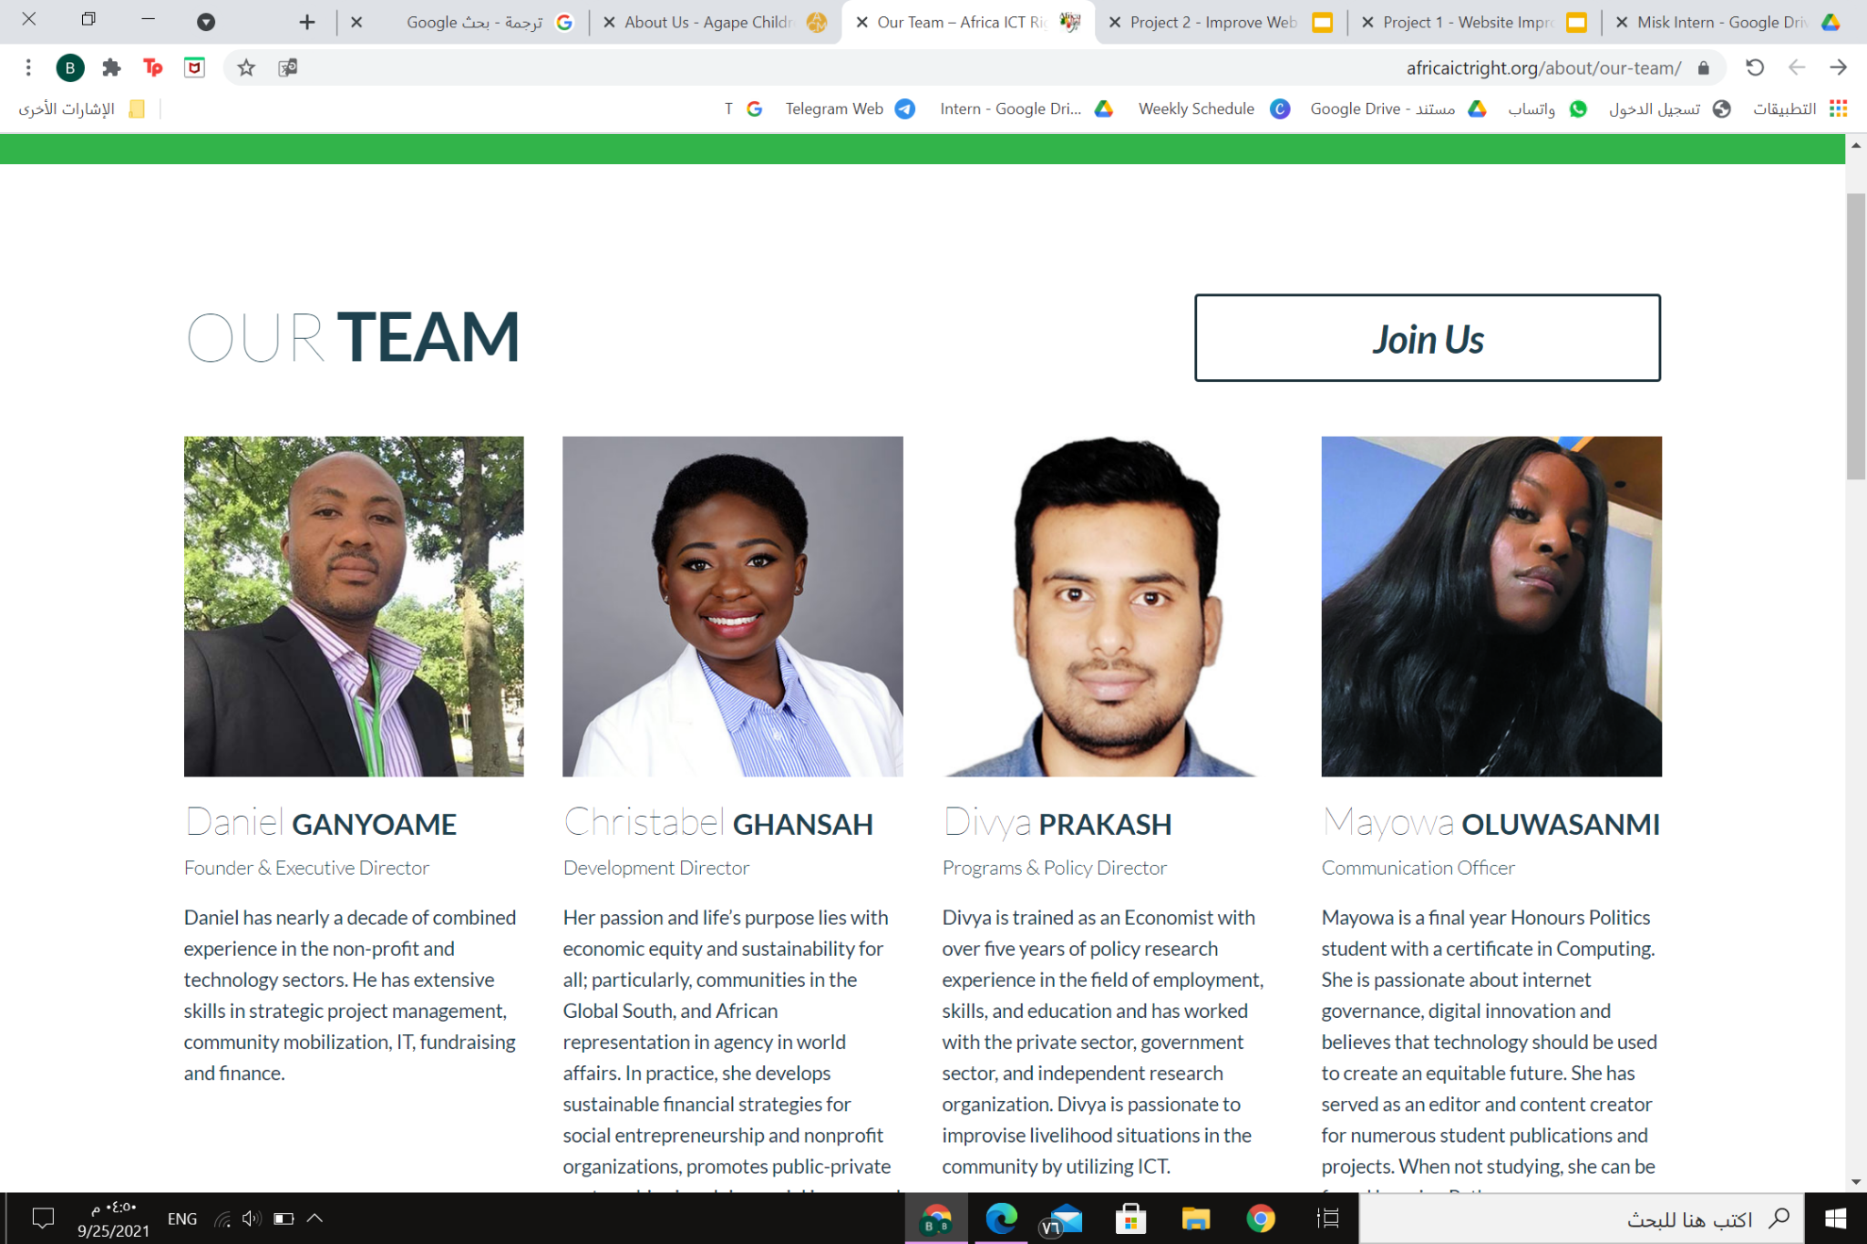
About / Our Team
Our Staff :
The most thing that we keep proud of in Africa ICT Right is Our Team, these full-time employees who are working tirelessly to empower underserved communities by providing technology for them.
Let's Meet some of our team leaders below.

Slide 24
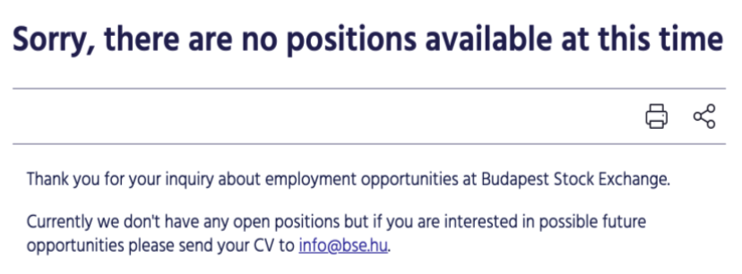
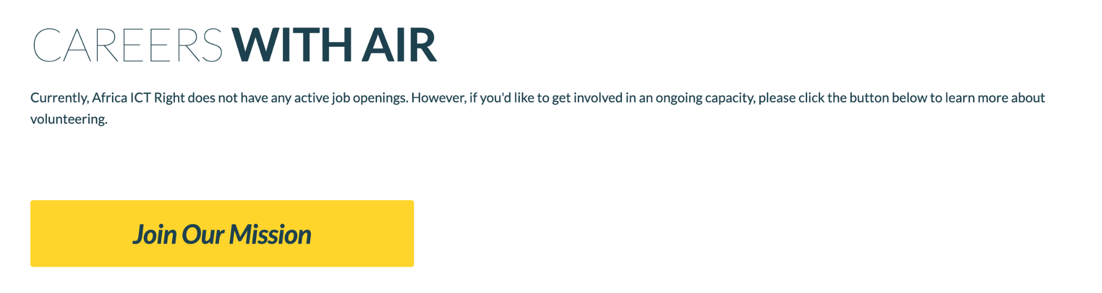
About / Careers
Remove (We don't have any jobs right now) Then Send A kindly Words:
It would be better to apologize first that (we do not have any job ) and to include some kindful words to encourage users to visit the webpage in future. Also a notification email list tab could be placed, to inform people who are looking for an update about the available work(or even the voluntary positions). The reason of such a change, is to let the users feel that this is a positive thing and that they need to visit the website again.
It is better not to show the negative message to the users because sometimes they could understand the negative message in a wrong way or make their action in a negative way.
Also, Careers is enough without the words (with air),because we don’t need to present any additional words (with air) doesn’t effect or do anything for the users and the users already now it's our career because they opened our website and fined this message in our website, if we keep writing an empty words to the users so this will waste our users time
or
Would you like to be the first to hear about our sustainable initiatives? Join our email list to receive news updates from Africa ICT Right as they’re published

Slide 25
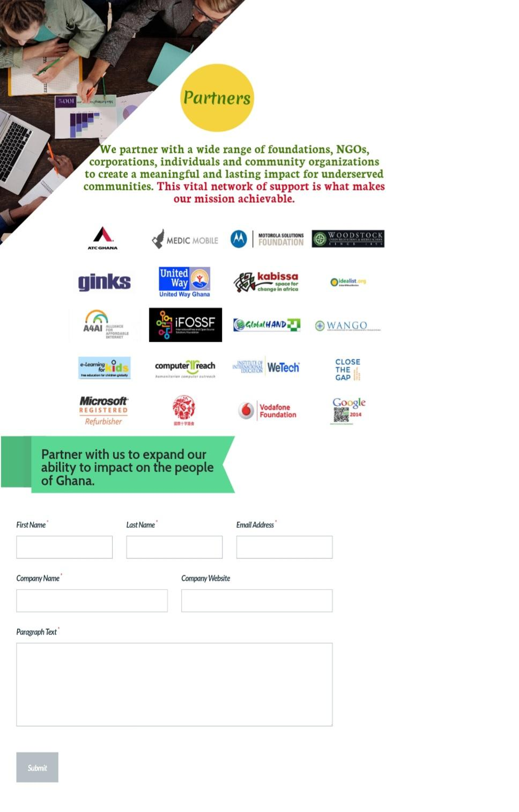

Get Involved / Partner
Re-editing the content:
An example of the look of this page.

Slide 26
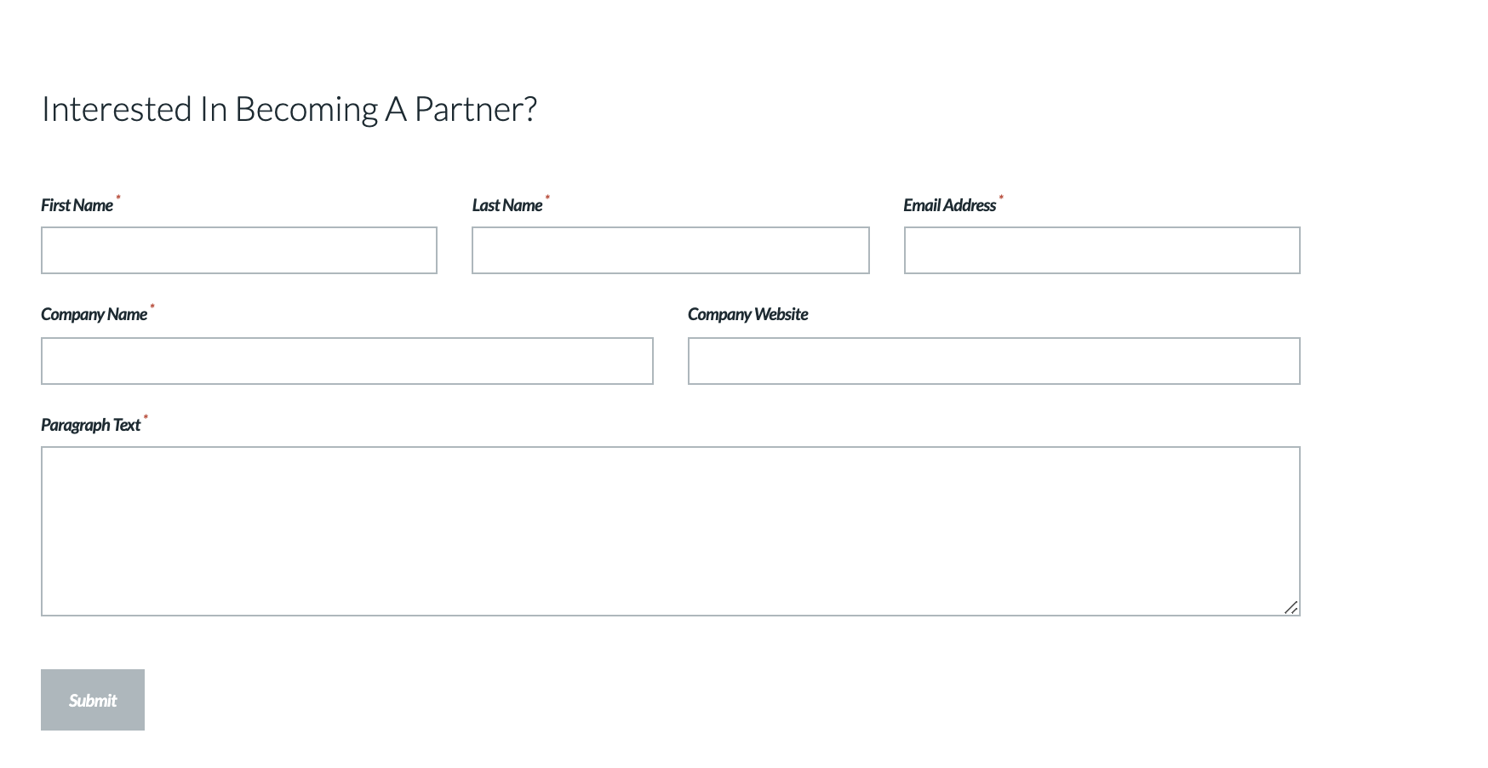
Get Involved / Partner
Use a Creative Words To make an Action:
We need here to make the users feel like it's the end of the world if they don’t help us to get our mission..
So here we can write:
Partner with us and save the world
Help our people to get their life equality and partner with us
Partner with us to expand our ability to impact on the people of Ghana.
And add more colors in this page, content or picture to get them feel it’s an active page.

Slide 27

Media / News
Remove The Names & Category - Add Search Box:
We don’t need to add the writer name by this way (by admin) and I think this is just an information for who’s adding this news not the writer of the news. If we have to add the writer name the one that he writes this news so we must be writing it into the page when we click read more and shows as a (first and last name or nickname).
Also we don’t need to category in the news because (news) already one of our content category. I think the blog doesn’t need to add the writer and the category, just we need to add a search box to search for any related words or category.

Slide 28

Media / News
Re-editing the topics
1-Africa ICT Right earned the 2018 Grant Award of Motorola Solutions Foundation.
2- Africa ICT Right features in the Omprakash Partner Development Grant. Or, Africa ict right got the Omprakash Partner Development Grant.

Slide 29
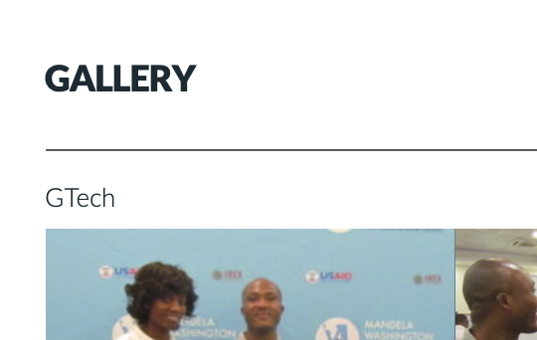
Media / Photo Gallery
Section Details:
We need more details about the photos and present a simple sentence that describes this section.
If we want to add the details information that we need to add for the main subjects we need first know that (what the photo that you want exactly to present here? is it all for projects photo?) if it yes so the main subjects must be: Project name - Date (the dates will be added depends on the new template)
And under the Gallery we must write that:
(( Where We Present Our Photo Projects ))
Where We Present Our Photo Projects
Date

Slide 30
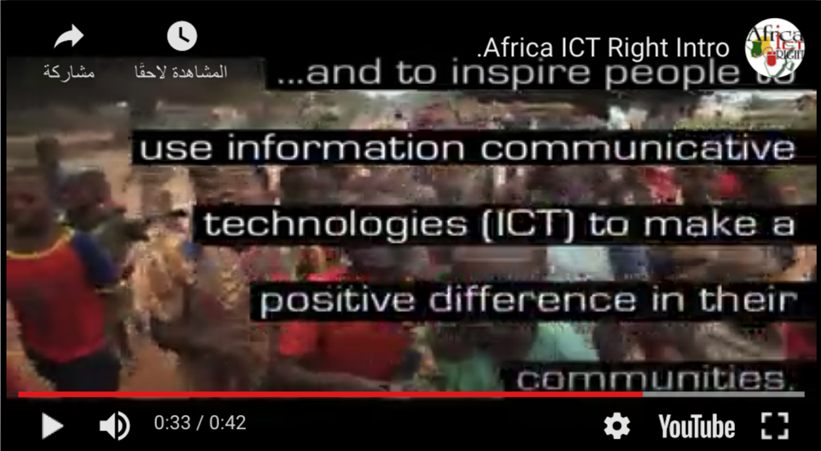

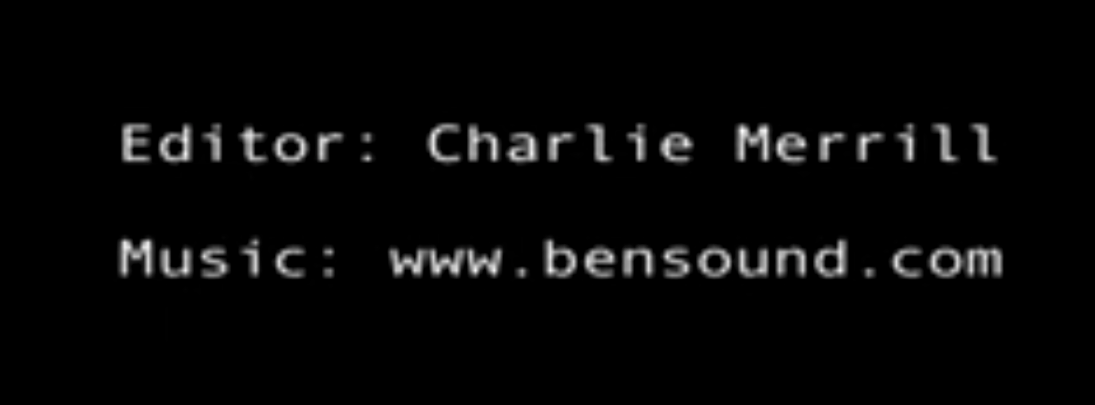
Media / Video
VIDEO NOTES / In The First Video:
1- The content with Black Background is wrong because it destroys the photo’s beauty
2- If we don’t have a high Quality video to use, so we need to choose from these solutions:
(create your video without the low quality video - take a fake video from the internet/ hire a videographer and make your great moments)
3- The LOGO is the most important thing in any enterprise so if we present it in a good way, we present our company in good way too. When we present our vide, we must to be careful to show as what we do as : (clear - high quality - full logo). Sometimes we can add it in the whole video in the footer or the header as a small logo)
4- I think it’s wrong to add in the advertisement video an Editors Information, and if we must do that, so we need to present it professionally ,as it shows after any movie ending with changing the font or write it in the youtube details for the best way.
Black Background
Quality
LOGO
Editors Information

Slide 31
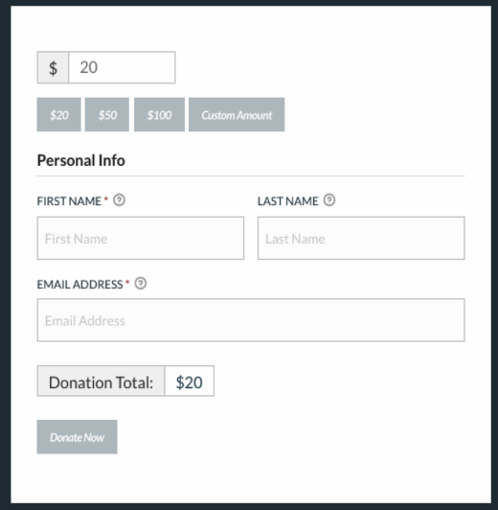
Donate / Header
Problem In The Page:
There is a problem in the donation page. When you enter to the page you can’t go back to the previous page, the header line is not shown in this page at all.

Slide 32
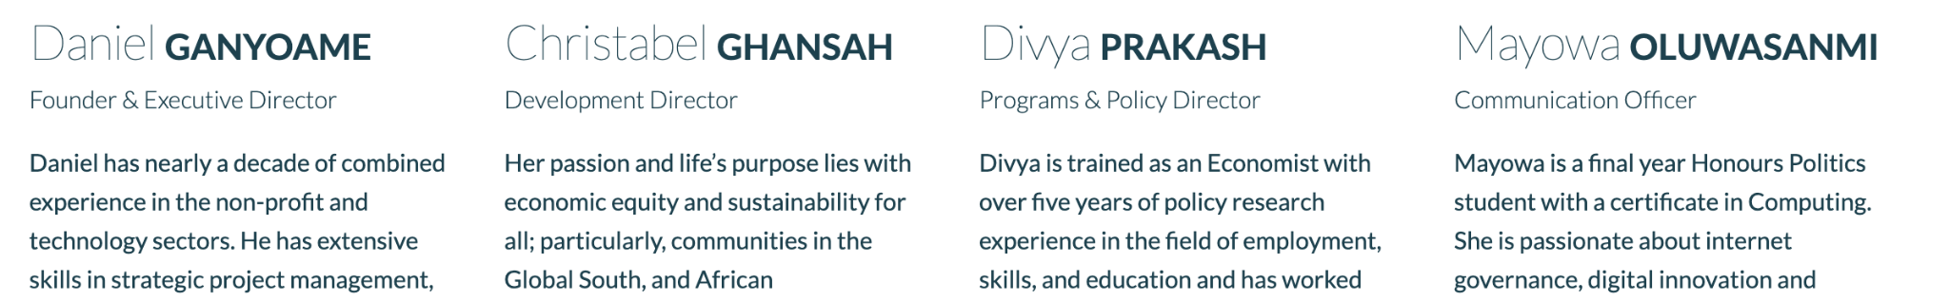
About / Our Team
Description Ways Details:
The details of the members are presented in a different style of writing, the passive voice can be seen in one or two members but not all of them. Like if we use (has) it is better to relate all of them in a past tense, or using present tense for all of them. As a reader it is not the best way to read a content , because you feel this content is not consistent to each other.

Slide 33
Get Involved / Volunteer
The Majority of our operations are entirely carried out by volunteers. No matter how small or large the role, volunteers are our most vital component. We pride ourselves in creating a fun, diverse and unique environment for our team of talented and dedicated volunteers
If you are looking for an experience where you can add values to people in life, Africa ICT right is the best place to make a difference.
We strive to match your skills and interests with our organizational needs to make the experience more meaningful.
Re-editing the content:
The available positions can be listed here with just a brief description.
Volunteer In Africa ICT Right
Development director:
Leading the development fundraising strategies and operational plans
Communication manager:
Being responsible of the organization's relations and developing the marketing content
Grant writer :
Will be writing papers and working in different areas of the organization plans
Including the tab of learn more
The insights of the volunteers with their pictures.

Slide 34
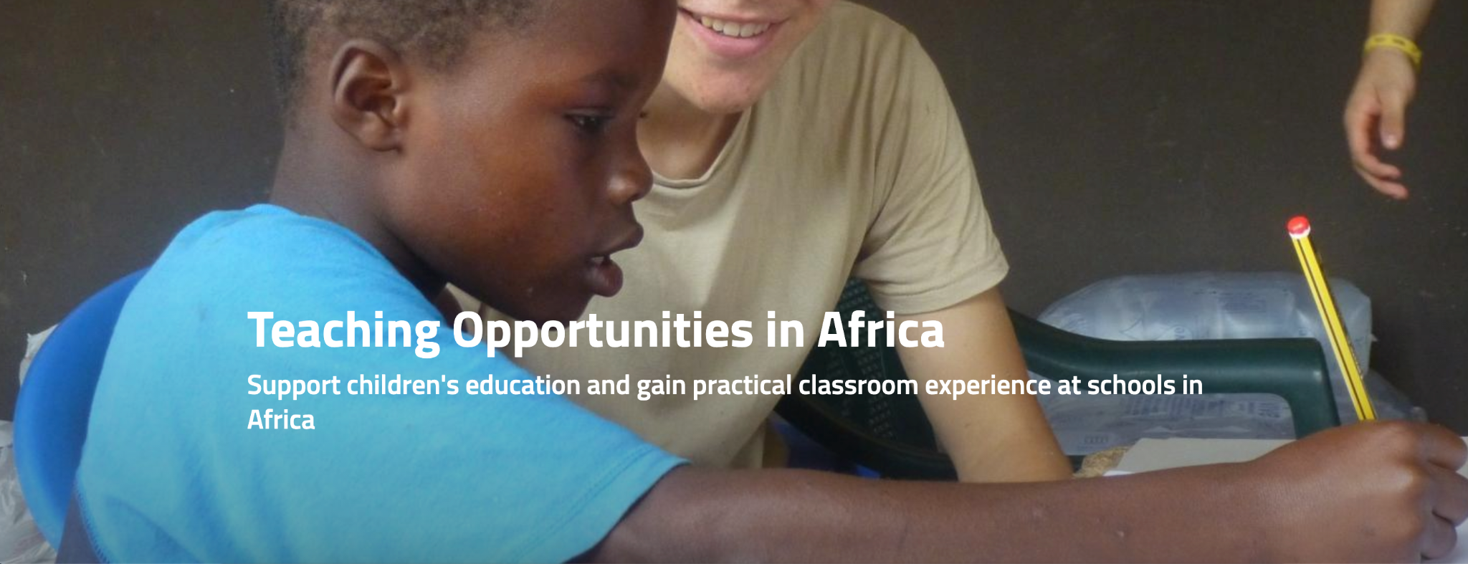

Get Involved / Volunteer
Design of the web page
Banner / Picture to match it with our area and volunteer
Banner Example
Overview:
……here the same content in the volunteer page…...
Current Opportunity:
Opportunity Location
Can't find what you're looking for?
We’d be happy to talk about creating a custom role for you.
Get In Touch
email:.... number:
To start planning your role..
contact us if you didn’t find your opportunity.
Bottom Example

Slide 35
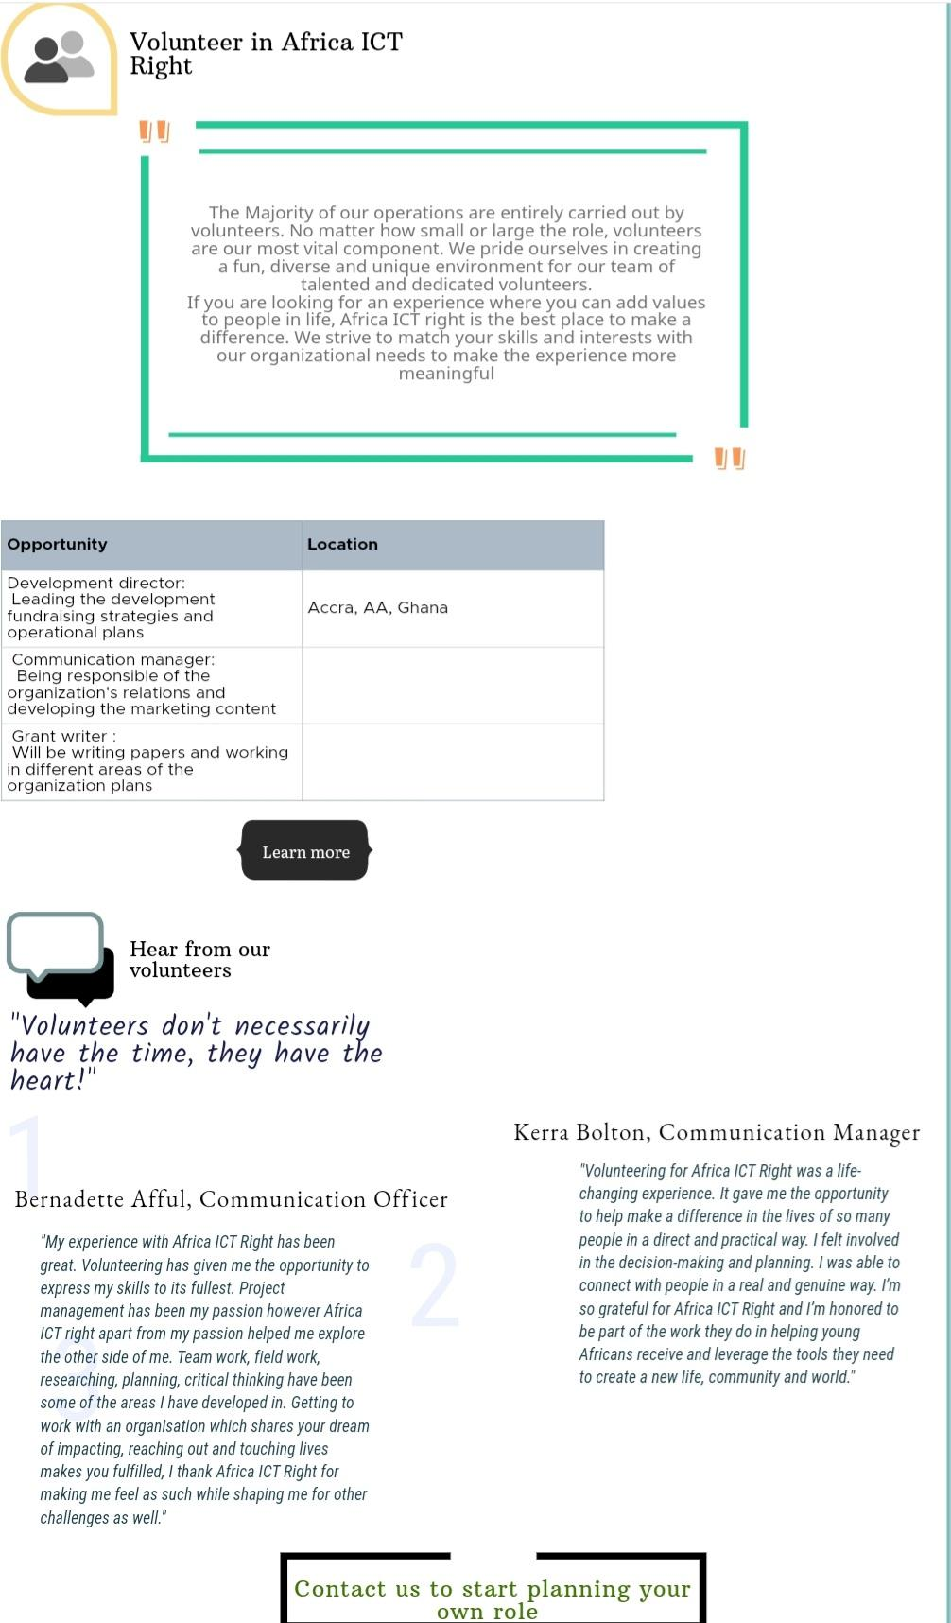
Get Involved / Volunteer
Example Design For The Page

Slide 36
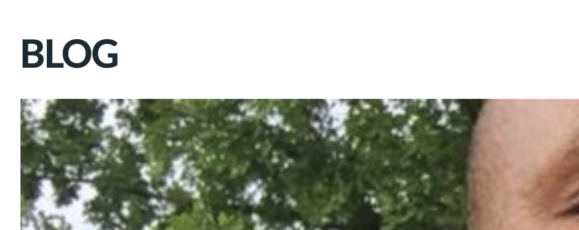
Media / Blog
Add A Briefe & Friendly Words Under Any Subject
you can add small description of what you will be posting in your blog, it will be nice for your users to read before they see the blog
(( Where we discuss our work,
thoughts, and process )).
Where we discuss our work, thoughts, and process

Slide 37
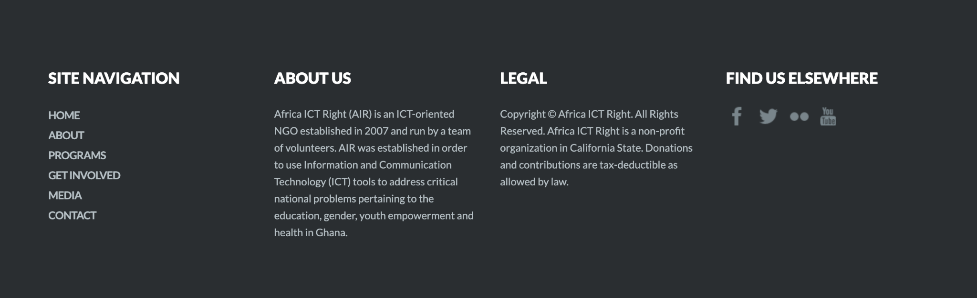
Home Page / Footer
Add Sections & topic:
Change the subject of the footer from 1 to 2 and add the most important sections for the users.
When we add links on the footer, we don’t need to add the main category we could directly put the subcategory.
The links that we need to add are important for our users to focus on it and view it more.
About
Home
About us
FAQ
Blog
Support
Volunteer apply
partner
Donation
Contact
Legal
privacy policy
Terms & Conditions
Cookie Policy

Slide 38
Examples:
https://www.communitysouthwark.org/
https://www.ipnlf.org/
https://africaeducationaltrust.org/
https://agapechildren.org/

Slide 39
Name:
Suhaila Alsheikhmubarak
Nada AlSalem
Budoor Alharbi

